Slide 1
Welcome to Essentials of IBM UrbanCode Deploy
Our session will begin shortly

Slide 2
Essentials of IBM UrbanCode Deploy Course code: QQ147
Course Overview

Slide 3
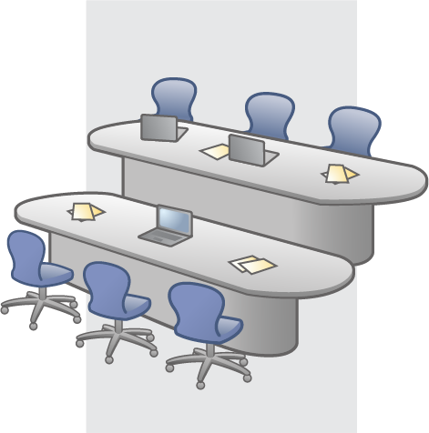
Intended audience
Primary audience:
Users
Configurators
Producers
Administrators
Secondary audience:
Administrators

Slide 4
Course description
This course introduces IBM® Rational® Urban Code Deploy
After completing this course you will know this information:
How UrbanCode Deploy solves customer problems
The workflow for a simple project
How key concepts and terms such as component, resource, processes are used in the product
How resources are organized and accessed
How to orchestrate deployments to different environments
You will also be able to complete these tasks:
Create a resource
Add agents to the base resource
Add a base resource to an application environment
Add component resources to the agents in the resource tree
Create components
Import artifacts from a build to create component versions
Identify the different kinds of component properties
Add components
Create component processes and add them to components

Slide 5
Course description continued
You will also learn how to complete these tasks:
Create an application and an environment
Create an application process
Update an application
Approve deployments
Examine the inventory and compliance for an environment and identify what versions of components are installed in the environment
Schedule deployments
Execute a deployment

Slide 6
Course materials
Materials for this course:
Slides
Lab workbook
Student workbook
Lab environment setup instructions
Videos

Slide 7
Course outline
Module 0: About this course
Module 1: Product overview
Module 2: Resources
Module 3: Components
Module 4: Applications
Module 5: Deployments
Module 6: Teams and roles

Slide 8
Essentials of IBM Urban Code Deploy Course code: QQ147
UrbanCode Deploy product overview

Slide 9
Agenda
Solving customer problems
Key terminology
Workflow
Explore the user interface

Slide 10
Module objectives
In this module you learn about:
Problems that UrbanCode Deploy helps to solve
A workflow for a basic deployment
The purpose of snapshots and inventory
User interface navigation
The UrbanCode Deploy topology
Server and agent communication

Slide 11
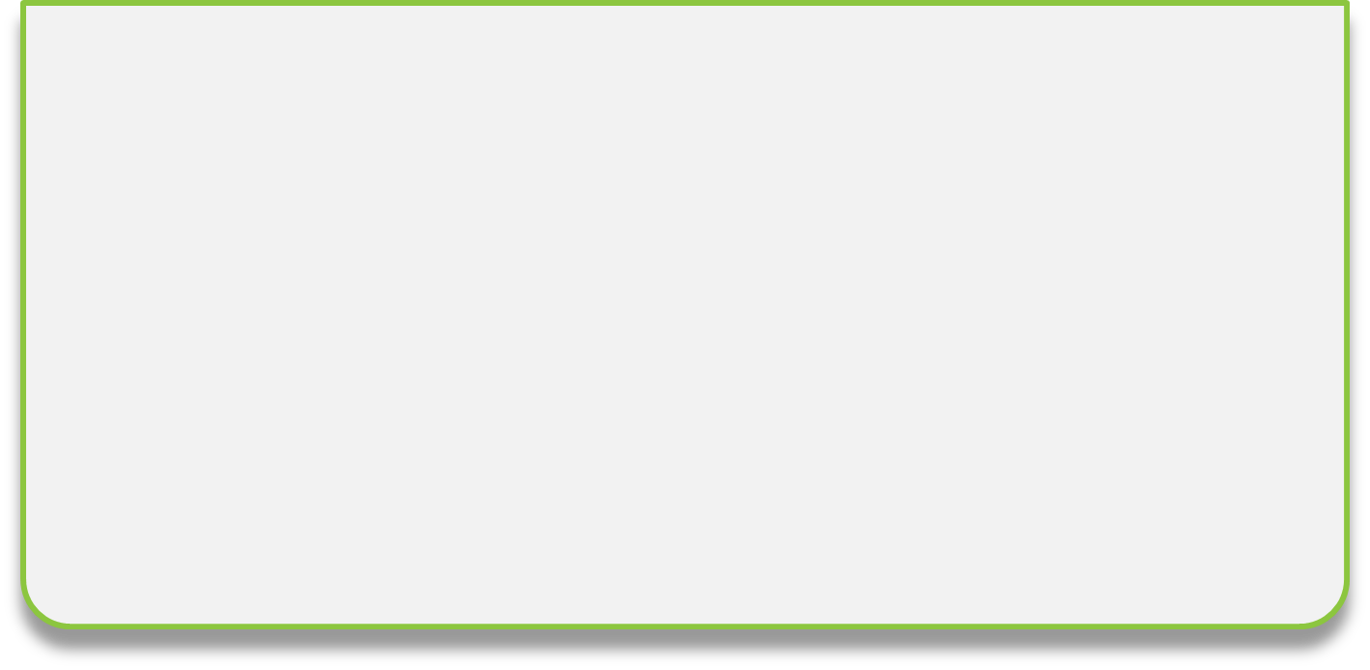







Deployment and release problems are serious business
CHALLENGES
CHALLENGES
Costly, error prone manual processes and efforts to deliver software throughout an enterprise are pain points.
Slow deployment to development and test environments leave teams waiting and unproductive.
Upgrade risks arise because of managing multiple application configurations and versions on servers.
Customers
Business Owners
Development and Test
Operations and Production
Knight Capital loses $440 million because of a misconfigured release (in only 45 minutes).
New Zealand’s biggest phone company, Telecom, paid $2.7 million to approximately 47,000 customers who were overcharged after a software glitch.
A bad software upgrade at RBS Bank left millions unable to access money for 4 days.
Notes:
An entertainment company routinely spent 2 weeks getting software to work in the test lab.
Most companies have deployment problems. Deployments require too much time, and they are done manually, very often with many errors.
Sometimes deployments must be completed in off hours because of the risk that is involved. IBM UrbanCode Deploy helps to eliminate the problem of many people working to complete a deployment that takes too long. Instantly put code in the production environment with UrbanCode Deploy. Sometimes you have people in different “silos” who don’t talk to each other in a company. You need to get the code out quickly to the right place. Developers must catalog and record what code is where. They actually might not know the versions that they put into the deployment environment, and they often deploy code that has bugs.

Slide 12







What’s going wrong?
Differences in dev and ops environments and procedures cause failures. | Time-to-market pressure generates more frequent releases. | Manual processes for release lack repeatability and speed. | Major releases take days; hundreds of people and are organized by spreadsheet.
Dev
Who did this last time?
I’ll order breakfast
Daily build
Dave…
Prod
Dave’s not here, man….
Release

Slide 13





Common application deployment problems
Costly delays
Manual handoffs
Lack of repeatable processes
Disconnected
environments
13
Notes:
There are many different types of deployment problems as noted here.

Slide 14
The UrbanCode Deploy solution
Automated, consistent deployments and application rollbacks
Orchestration of changes on servers and tiers
Configuration and security differences between environments
Clear visibility: What is deployed where and who changed what
Integration with middleware, provisioning, and service virtualization
Notes:
UrbanCode Deploy reduces deployment time. You reduce reliance on “superheroes.” You don’t eliminate superheroes, but you make them better. You help them to be more effective, deploy faster and with fewer errors. Deployments become so easy that almost anyone can do it. Much of the deployment process with UrbanCode Deploy is “push-button easy.”
UrbanCode Deploy is a single source of honest information: the product is one place that people can go to and see what is installed in what environment.
Developers can deploy different parts of an application, such as databases, and web stuff which are different. Security: Developers can test environments early but not when an application is in production. Database passwords are different in development or test environments versus production environments. You track environment-specific differences.
Visibility is clear in the inventory: Certain developers, for example, know how to deploy to IBM WebSphere already so you don’t have to discover how to deploy to it. The tool helps track that knowledge.
Customers may have built their own scripts and they may have tried to solve problems themselves, but it’s not going to get them all the way. Some customers say that they already have automation. UrbanCode can do it better.

Slide 15
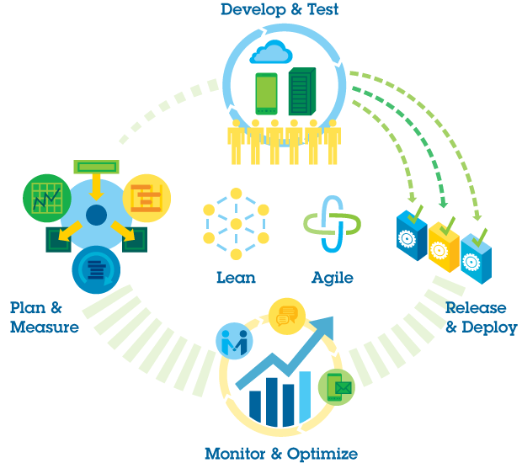
IBM DevOps architecture
Enterprise capability for continuous software delivery that enables clients to seize market opportunities and reduce time for customer feedback.
People
Process
Technology
Develop/Test
Accelerate software delivery
Balance speed, cost, quality, and risk
Reduce time to customer feedback
Steer
Deploy
Operate
DevOps Practices Self Assessment tool.
Blog that explains the Self Assessment tool: https://ibm.biz/BdRUbh
Direct link to the tool : https://ibm.biz/devops-practices-assessment
15
Notes:
Deployment is at the heart of the DevOps architecture. DevOps is a philosophy of lean and agile principles. IBM UrbanCode Deploy is part of the DevOps story. It is a tool that supports the philosophy and facilitates continuous deployment. It helps you spend more time on high-value tasks.
IBM’s approach to DevOps https://ibm.biz/BdRSTS
Adopting IBM’s approach: https://ibm.biz/BdDaMe
Workshop assets: https://ibm.biz/BdR6Dq
Workshop Four Steps:
Step 1: https://ibm.biz/BdRywU
Step 2: https://ibm.biz/BdRqpT
Step 3: https://ibm.biz/BdRnWi
Step 4: https://ibm.biz/BdRn7u

Slide 16
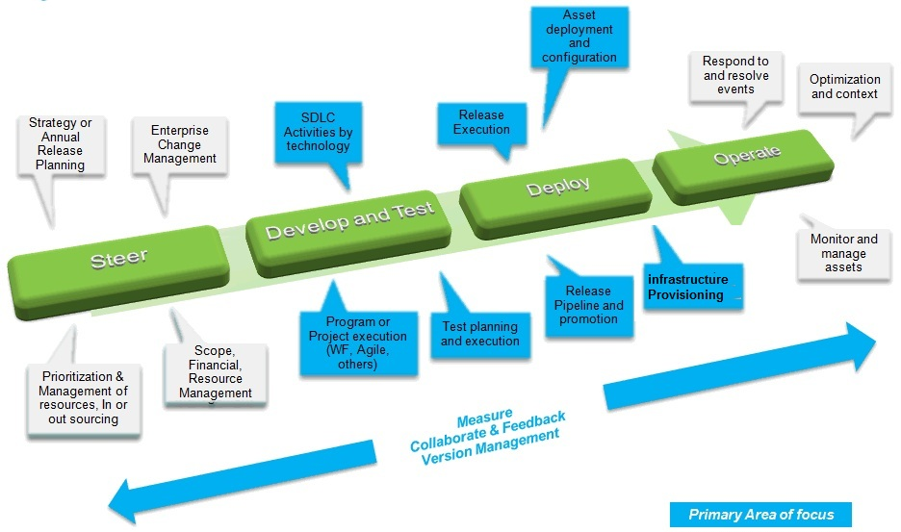
Urbancode Deploy focus areas in the DevOps process

Slide 17
Deployment definition
“Deployment” is the process of completing these actions:
Selecting component versions from a repository.
Moving those components to one or more targets, such as a web server.
Completing the required tasks for bringing those pieces of the application online.
For example, a deployment might remove the previous version from an application server, install a new version, and then start the new version.
Notes:
Selecting application components from a repository:
JAR files
WAR files
Database files
EAR Files
Compiled files
Typically an application includes 3 - 6 environments. There are at least two test environments.

Slide 18
UrbanCode Deploy
Deployment is the process of moving software through various preproduction stages to final production.
What refers to the deployable items: binary files, static content, middleware updates, database changes and configurations, and anything else that is associated with the software that IBM UrbanCode Deploy delivers to targets.
How refers to combining deployable items with processes to create components and designing applications that coordinate and orchestrate multicomponent deployments.
Where refers to the target's hosts and environments.
Notes:
Typically, each stage in the deployment represents a step of higher criticality, such as quality assurance to production. Moving software is broadly defined. Software could refer to binary files, static content, software updates and so on.
Change happens in the context of an application. An application brings a relationship among components, security, and governance in environments. An application is a core organizational structure of the tool that brings pieces together. An application is a program that assembles blocks together so they can be deployed and tested easily. Components are associated with an application. People think of components as belonging to a single application. It is uncommon for a component to be used by multiple applications. You assemble versions of components to create a snapshot.

Slide 19

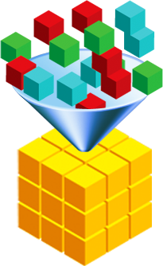

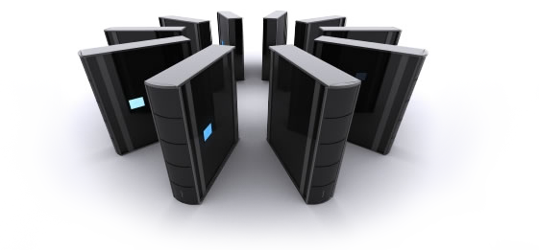





Intuitive and scalable model-driven deployment
The “Where”
Reusable workflows
Composite applications
Environment management
SIT
The “How”
PROD
The “What”
Deployment automation
Components
19
Notes:
Application
A top-level structure to bind processes, properties, and component versions together
Components
Tiers or services of the application, each with distinct processes and properties
Environments
Target servers
Environment-specific configurations
Processes
Coordinate component-level processes
The same processes are used among environments

Slide 20
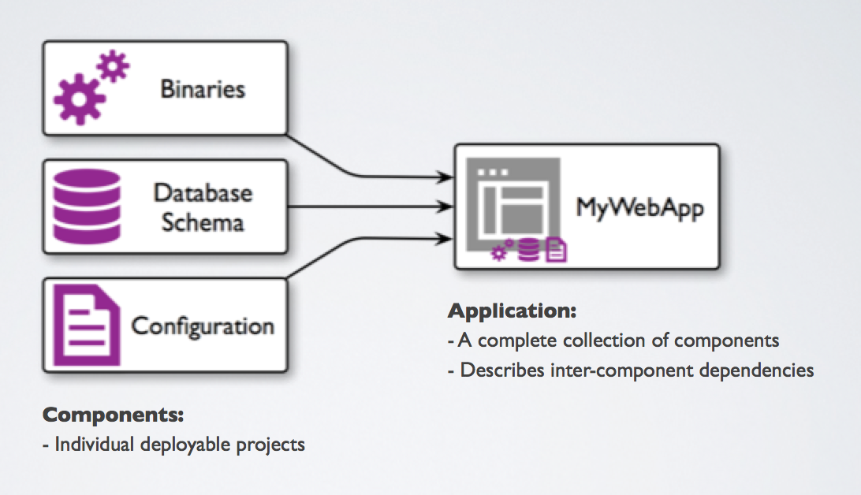
Application model
The “What”
Reliably capture application content and configuration settings with versions and traceability.

Slide 21
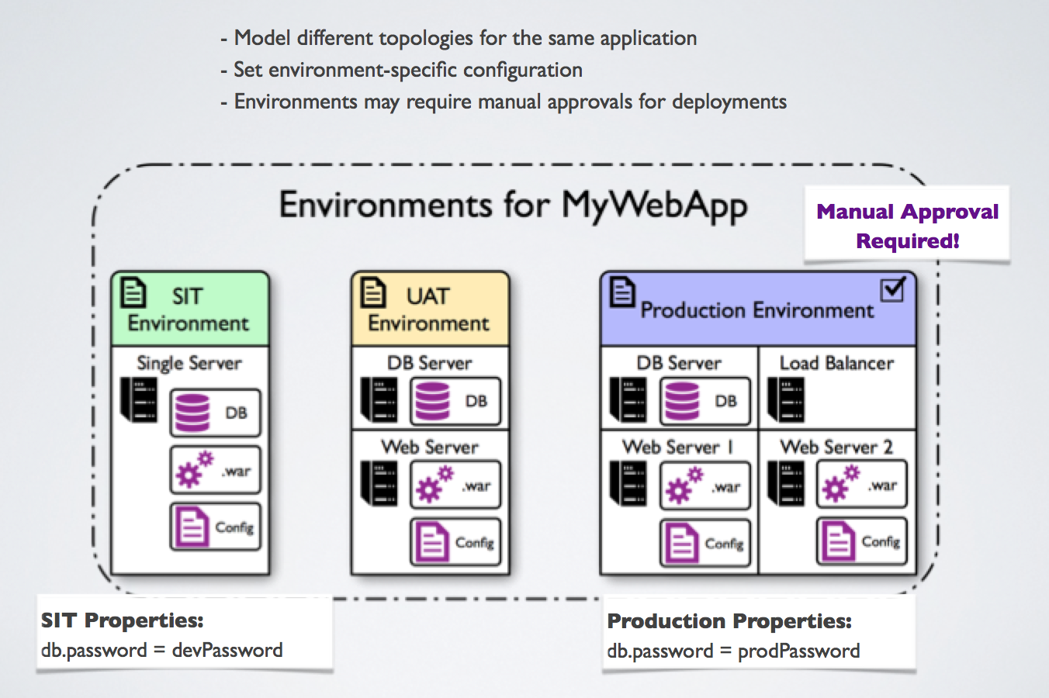
Application environments
The “Where”
Define where components are deployed and capture configuration settings per deployment environment for an application.
21

Slide 22
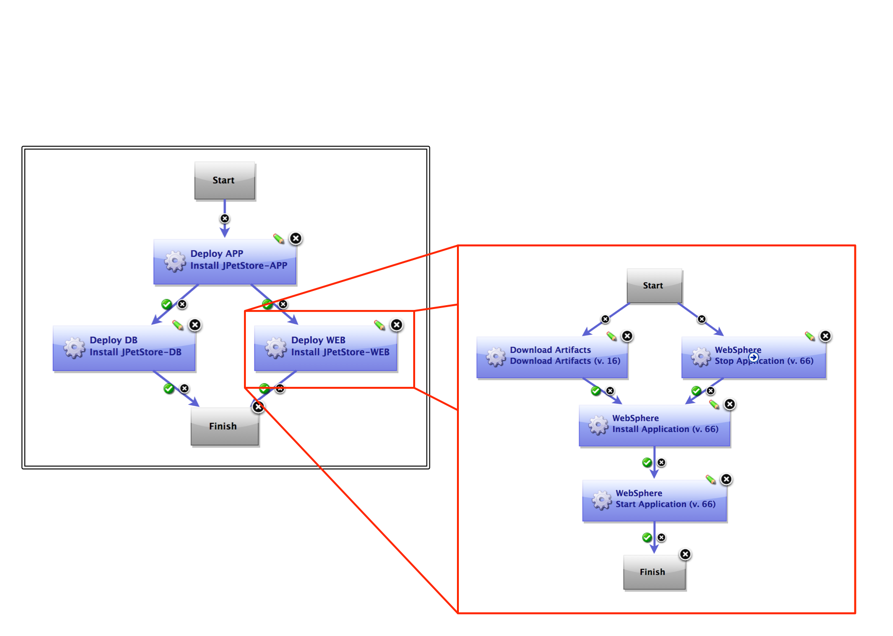

Deployment processes
The “How”
Deploy the application
- Orchestrate the deployment of many components.
- Represent deploy-time dependencies
Deploy the component
- Create a fully automated workflow to be executed on target servers
Use a drag-and-drop workflow designer.
Precisely control of execution flow.
Use hundreds of integration steps are provided
Create custom steps.

Slide 23
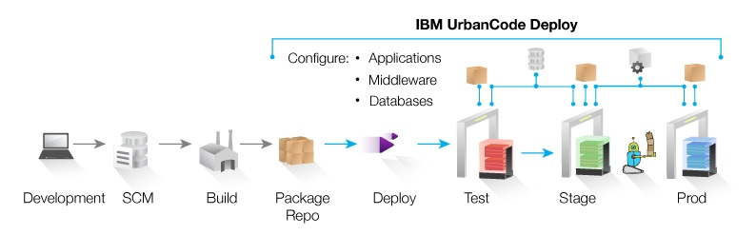
The continuous delivery pipeline

Slide 24
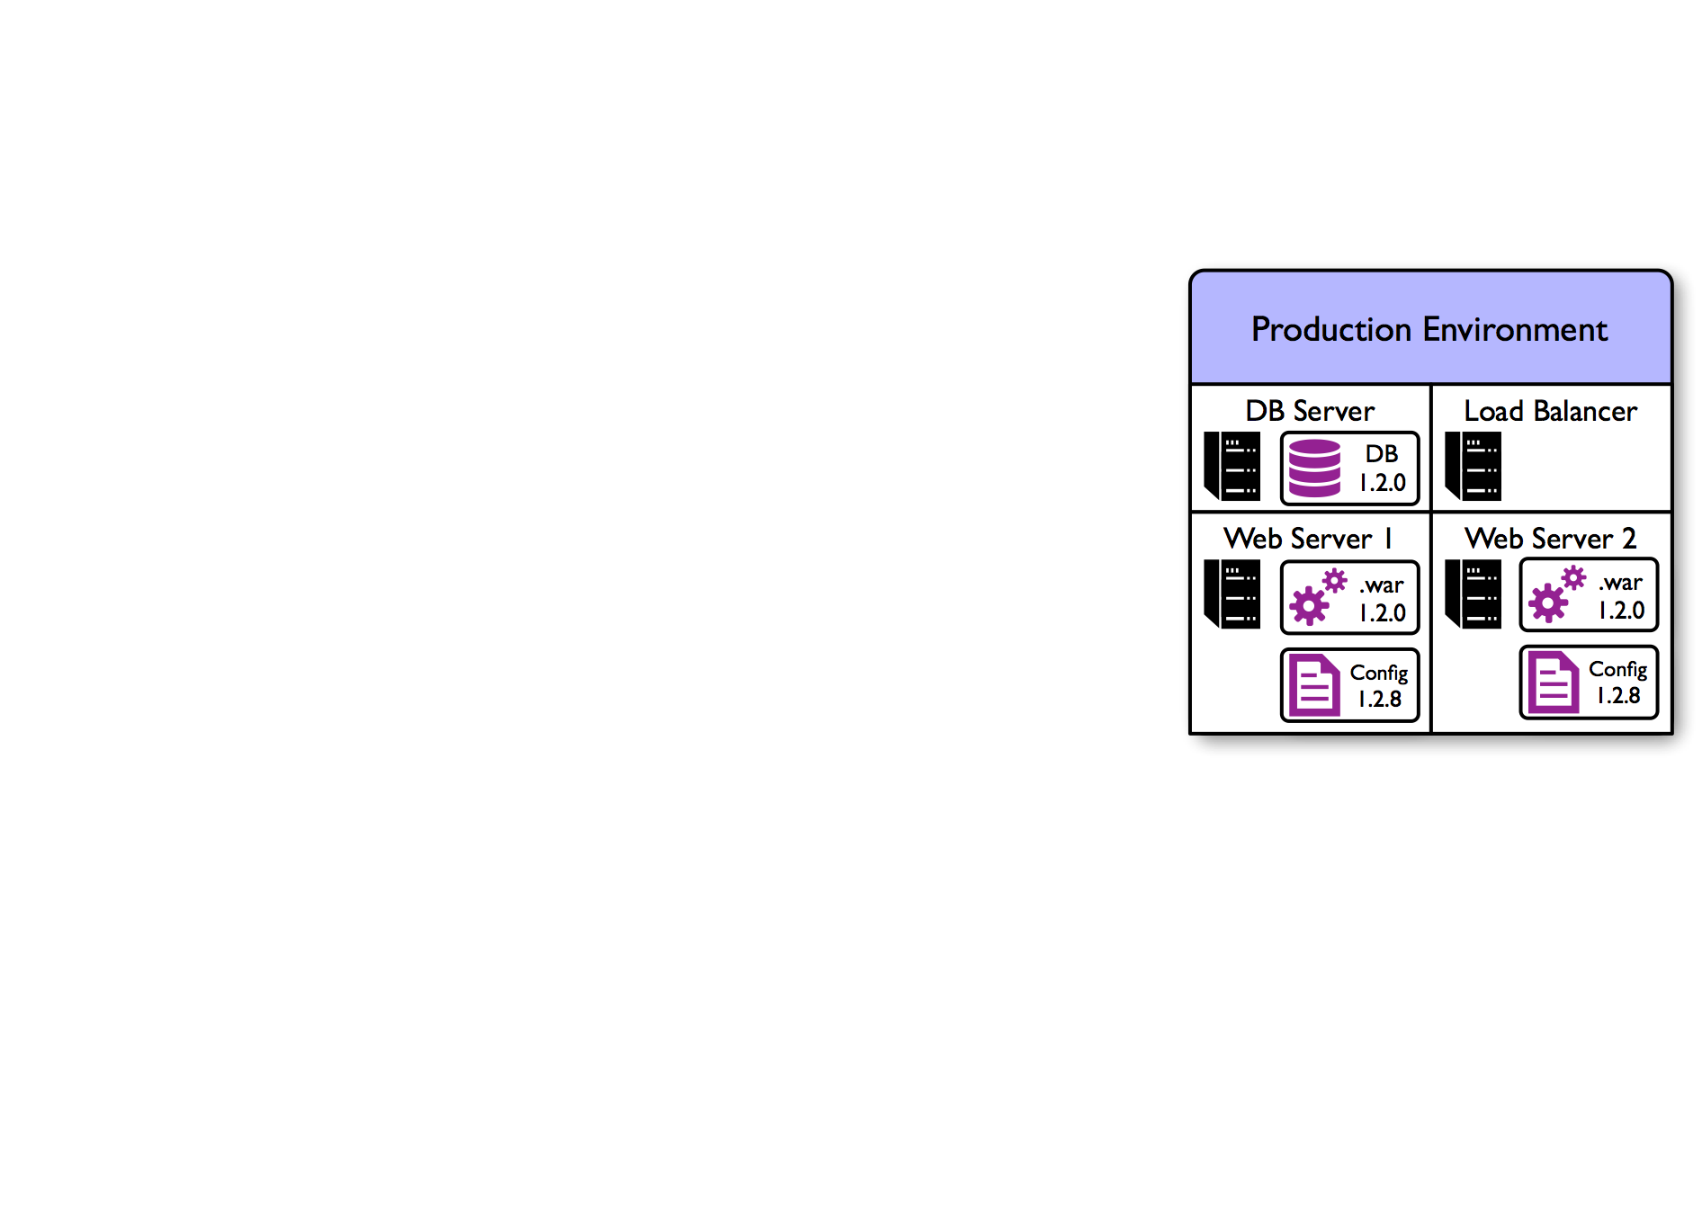
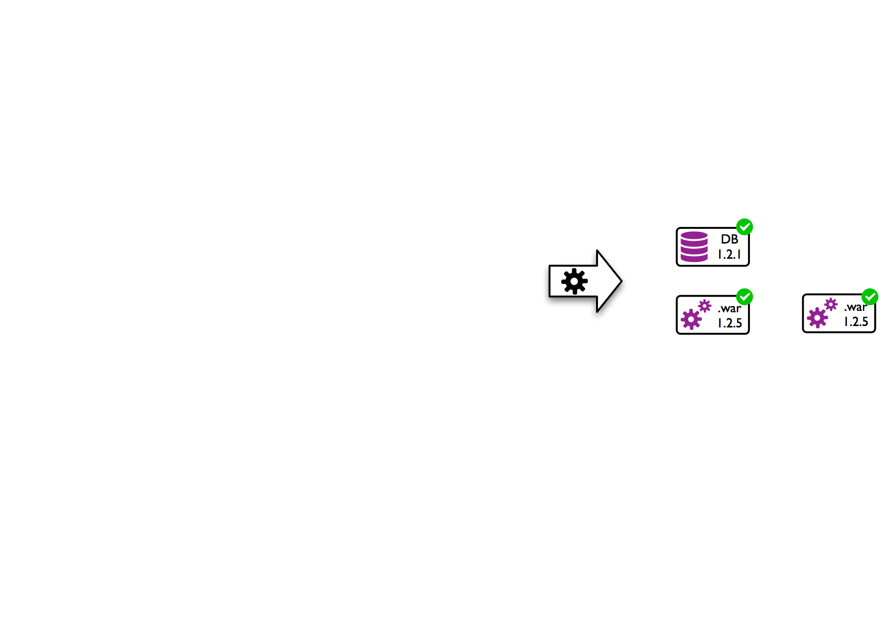
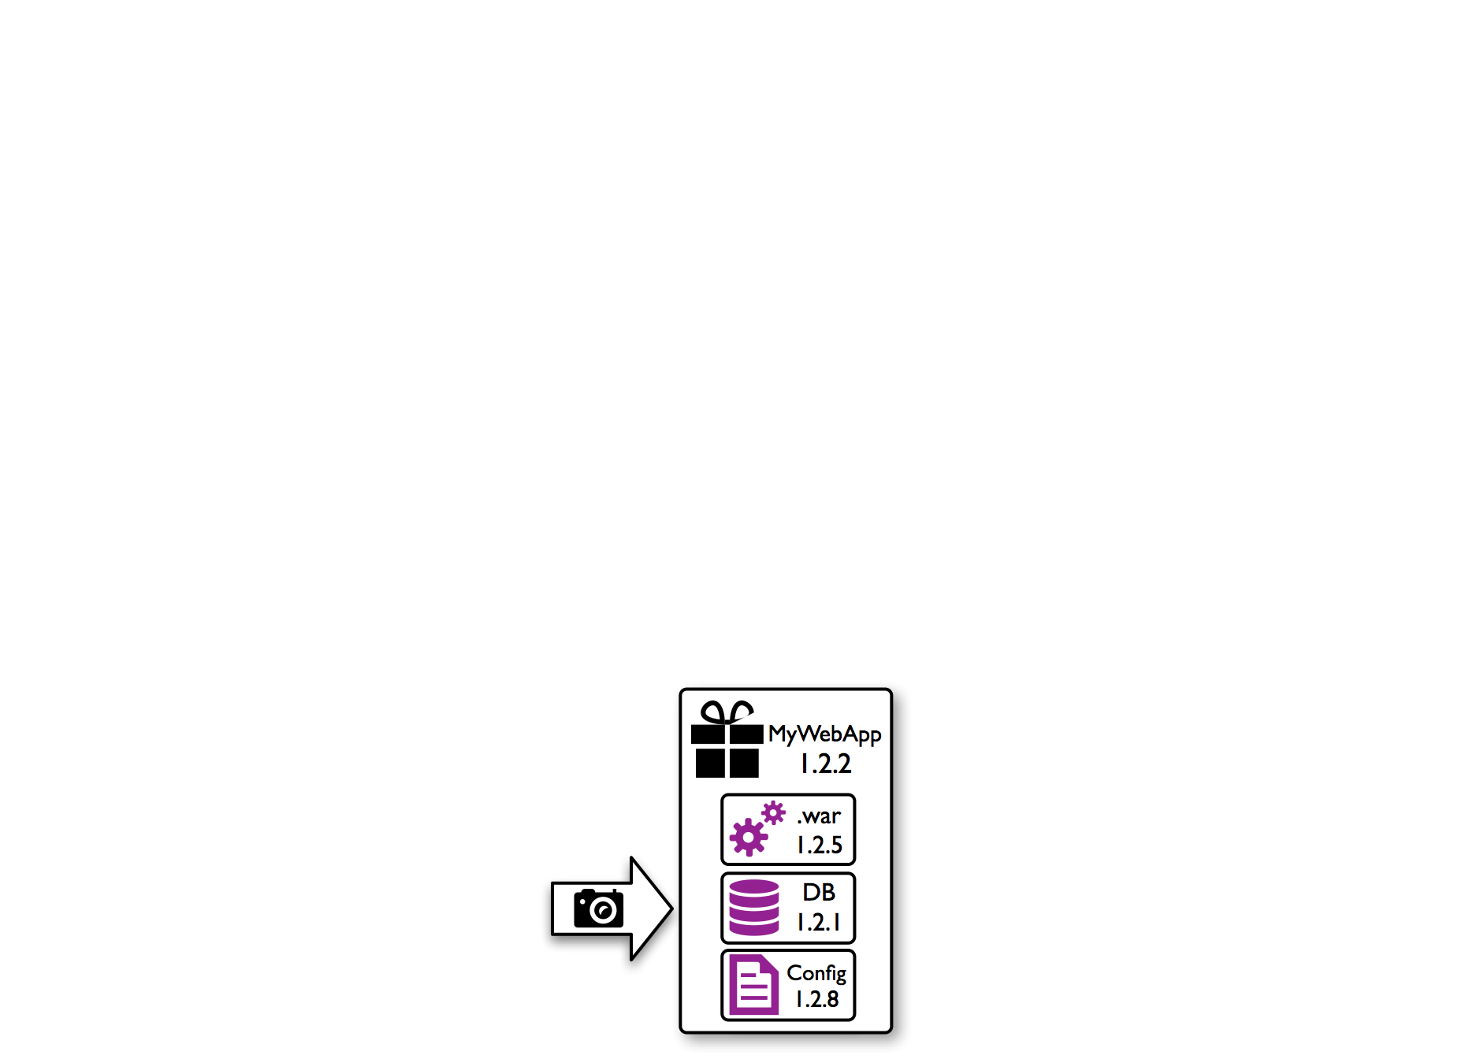
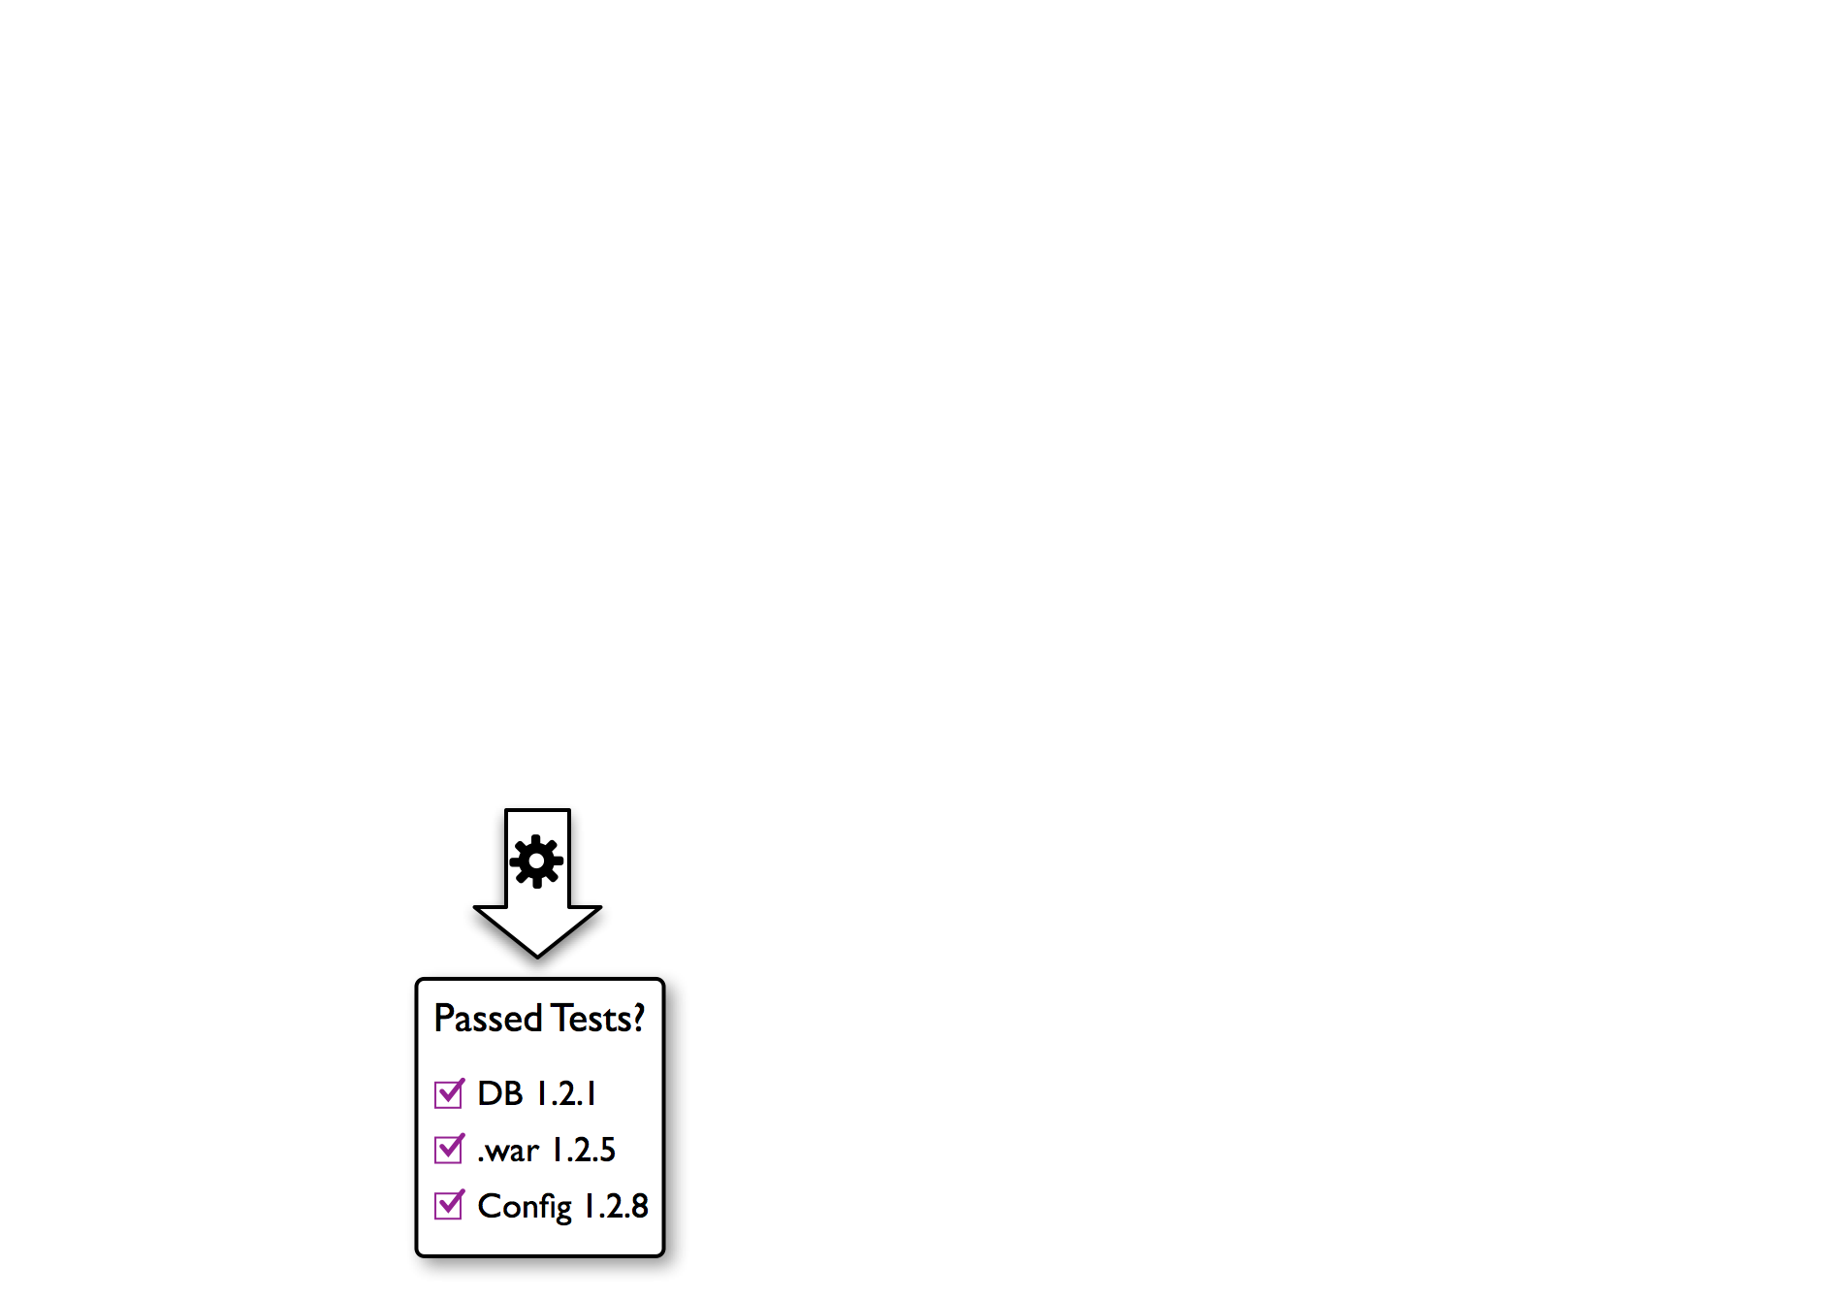
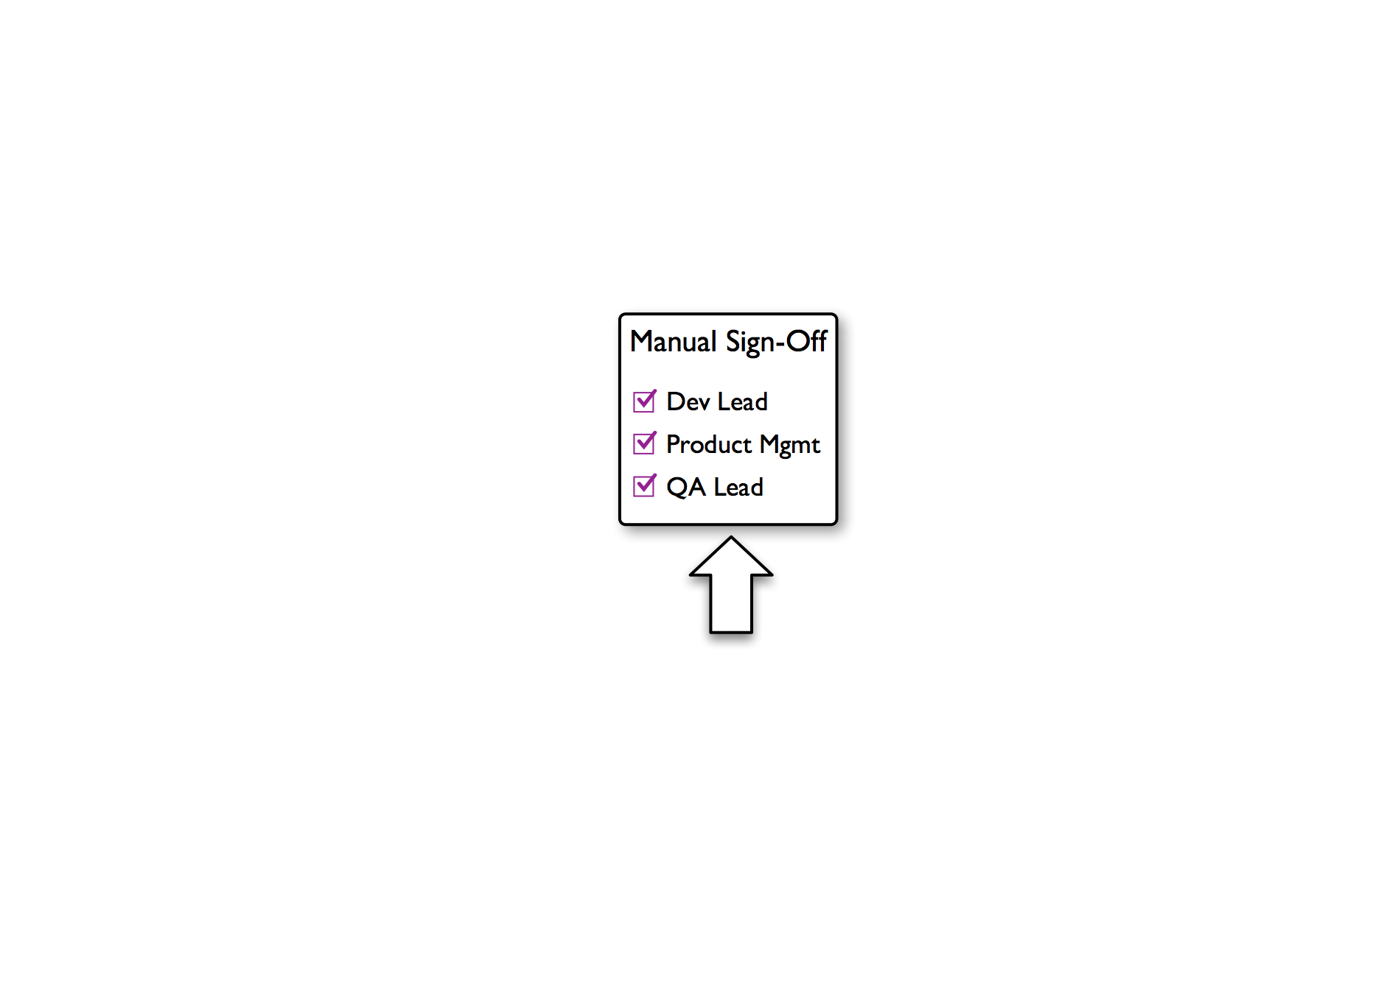
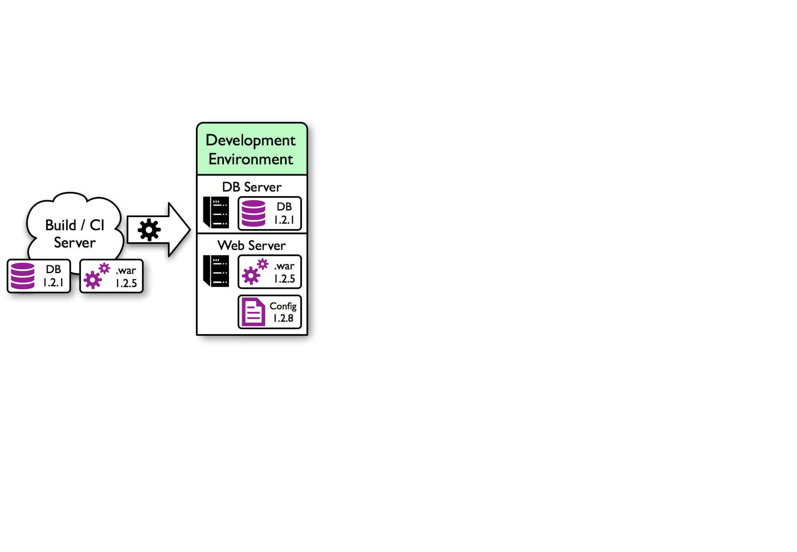
Putting it all together: Continuous delivery
On build completion, the latest artifacts are published to UrbanCode Deploy and deployed to a development or SIT environment.
Before any deployments to production, manual approvals are required.
After deployment, automated tests are started. If they pass, we mark the tested versions as such.
The exact combination of component versions which passed tests is captured in a snapshot.

Slide 25
Installation elements
UrbanCode Deploy server
The main server provides a web interface for administration and user operations.
The server manages authentication and authorization for users (LDAP integration is available too).
The server orchestrates integrations with other elements: agents, other IBM software, or third-party software.
Agents
Are installed on each deployment target.
Communicate with the UrbanCode Deploy Server to receive file transfers and initiate operations on local computers to install and initiate the application pieces.
Local operations are accomplished with “plug-ins.”
Agents include Groovy libraries for running plug-ins, but plug-ins can be written in any language or format that provides execution capability on the local computer.
Relay server (optional)
Notes:
The Relay server:
Also known as “Agent Relay.”
A server that is used to “relay” commands from the main UrbanCode server to the agents.
Used to cross firewalls, where communication to multiple machines and ports is restricted.
An agent doesn’t have instructions to do anything. The instructions come in the form of a plug-in. To run a shell command, there is a shell plug-in. Many WebSphere plug-ins are available.

Slide 26
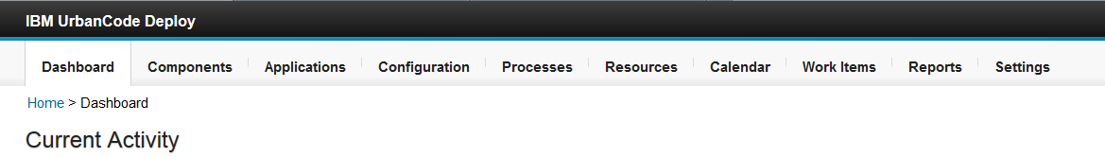
Welcome to UrbanCode deploy
Represent deployable items and the processes to deploy them
Orchestrate component deployments
Add properties to applications, components, and environments
Are generic processes that run outside the context of components and applications
Represent a deployment target
Shows scheduled deployments
Notes:
Work items: If a job requires approval, an approval process must be created. Then, the job is displayed in the approver’s Work Items tab.
Until it is approved, the job remains idle if it is unscheduled. If time runs out on a scheduled job that requires approval, the job fails. With this control, the approver can verify the deployment details and choose the time that it is deployed. Notifications are sent to users who are eligible to complete an approval step if the system is configured with an email server and the user has a set email address.
Reports: IBM® UrbanCode Deploy provides deployment and security reports. Deployment reports contain historical information about deployments. Data can be filtered in various ways and reports can be printed and saved.
Settings: The tables under settings list several system-wide settings. There are security settings, artifact cleanup settings, licensing settings, and so on.

Slide 27
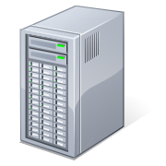
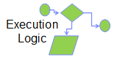
Web applications
Web applications are made of multiple pieces:
They are often created by many different groups, including third parties.
They are updated on separate schedules and have different version numbers.
They are installed on multiple pieces of hardware at run time.
Web servers
App servers
Database servers
Application user
Web pages
Data structures
Database architects
Page designers
Programmers
Note: You can use UrbanCode Deploy for any kind of application code distribution, but web applications provide the best illustration of its value.
Notes:
Many organizations have multi-tier applications and different people work on different parts. UrbanCode Deploy helps people collaborate. You typically have different people and groups working on different components.

Slide 28
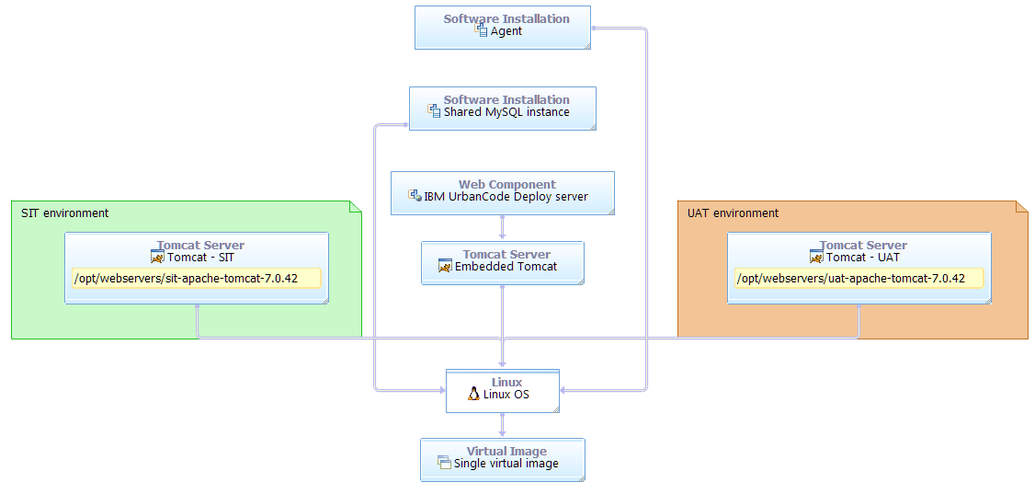
Architecture and environment before the lab exercise
The lab is set up with one agent and two-servers as deployment targets.
Notes:
Three instances of Tomcat: one is embedded in the UCD installation, one is running on port 8085, and the other is running on port 8086.
Because this is on one virtual environment, there is one agent. However, in a real-world scenario, the SIT and UAT environments would be on different servers with different agents.

Slide 29
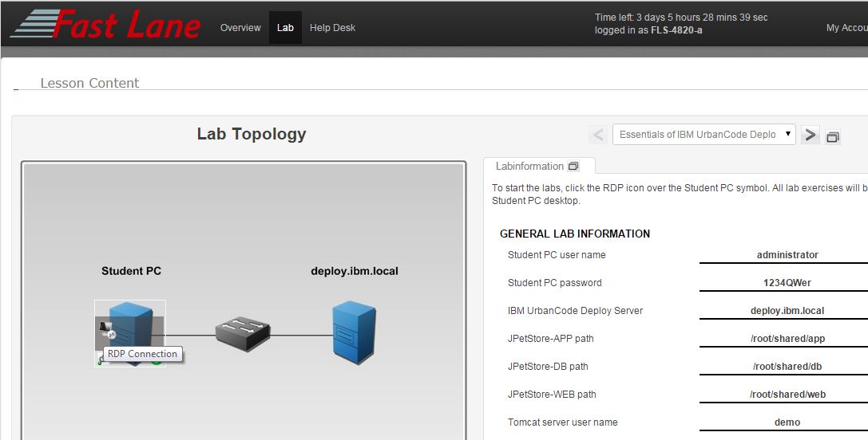
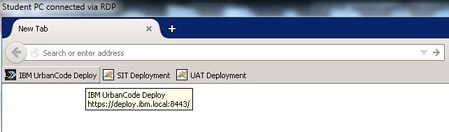
Your lab environment

Slide 30
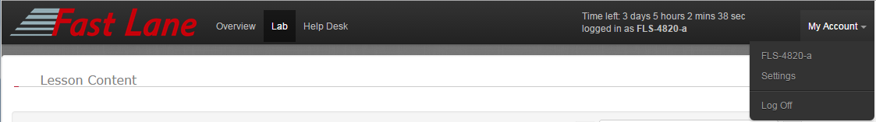
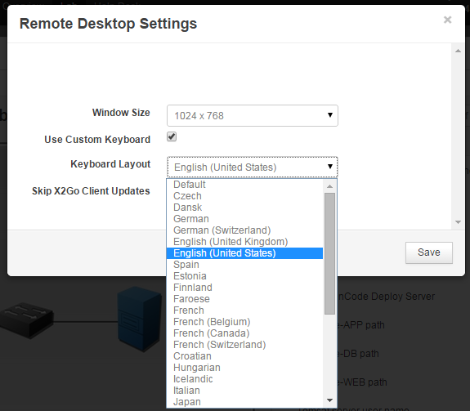
Lab environment settings

Slide 31
A basic workflow
Create a base resource.
Add an agent to your base resource.
Create a component.
Add versions to your components.
Add component processes to your components.
Create an application.
Add components to your application.
Create application processes.
Create application environments.
Add a base resource to the application environment.
Add to the agents in resource tree component resources for each component that is used in your application
In the application environment click Run Process
Notes:
Step 1 starts after a user has completed the login and seen the dashboard.

Slide 32
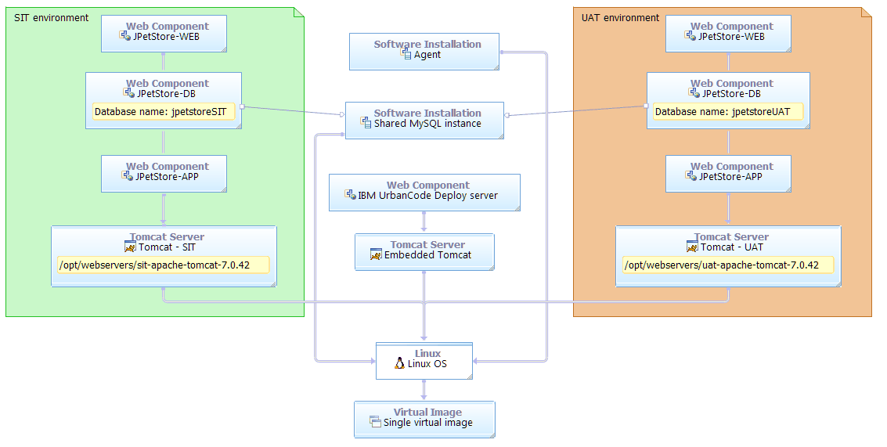
Architecture and environment for the JPetStore lab exercise
After the lab is complete the components have deployed as shown below:
Notes:
The components are deployed to the SIT and UAT environments.

Slide 33
Different groups use different component versions
Editors might use the latest version that exists.
QA uses a combination of old and new components.
QA tests “candidate” application releases to make sure they work together without errors.
Multiple combinations of versions might be in various test stages.
Production uses only versions that are proven to work together without errors.
Development systems
v6
v4
v2
QA systems
v4
v3
v2
Production
systems
v1
v1
v1
Notes:
Early environments have the latest versions, while production has components that are proven to work together.

Slide 34
IBM UrbanCode Deploy
UrbanCode Deploy gives engineers a way to quickly manage what pieces go where.
Build or release engineer
Development environment
v6
v4
v2
QA environment
IBM UrbanCode Deploy
v4
v3
v2
Production
environment
v1
v1
v1

Slide 35
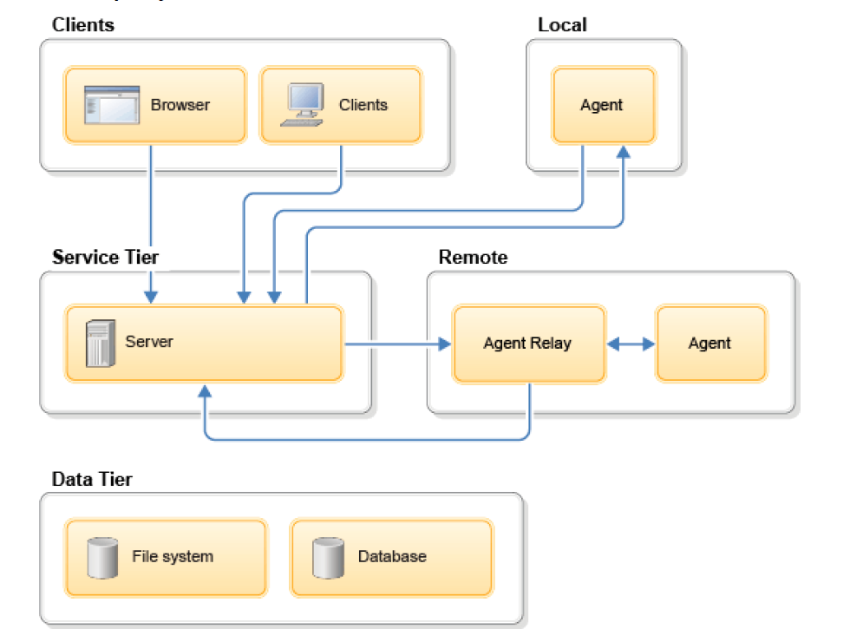
UrbanCode Deploy topology

Slide 36
The UrbanCode Deploy key elements
UrbanCode Deploy maintains these elements to represent deployment activities and artifacts:
Components: The pieces of your application that are being deployed.
Applications: The collection of components that are deployed together.
Resource: The target of a deployment; a computer where an agent is installed.
Environments: A collection of resources (computers) where an application is hosted.
Snapshots: A collection of specific versions of components.
Processes: A list of steps that operate on a component. These steps include moving a component to a target environment and acting on that environment to initiate the running application.
Plug-ins provide basic functions and provide an extension point for integration with other software.

Slide 37
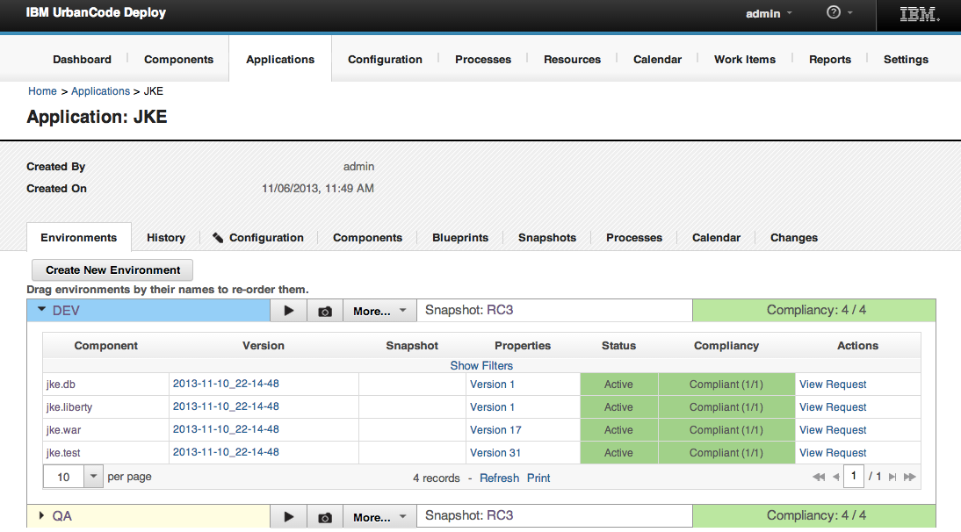
UrbanCode Deploy automation benefits
Get visibility and automated control of your application deployment process.
Manage application components and versions.
Manage configurations among all environments.
Offer secure “self-service” capabilities.
Increase transparency.
Ensure governance and compliance.
Notes:
37

Slide 38
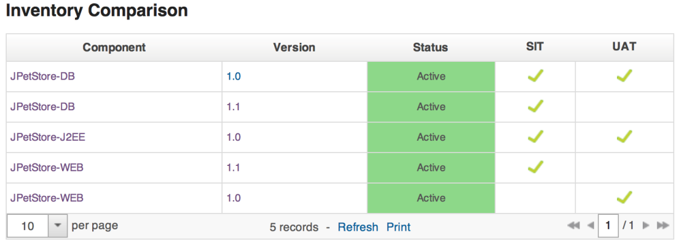
Inventory
Inventory shows what versions are “where”:
Environments and resources
Resources (deployment targets) support different scenarios.
When did the component get there?
What used to be there?
How do things differ?

Slide 39
Snapshots
Create a snapshot after testing
Snapshots contain deployable components and configuration
Deployment changes are tracked by default
Snapshots help in these areas:
Automation, audits, and visibility

Slide 40
Components, applications, and snapshots
Fix bugs
Add features
Remove obsolete functions
Components
PetShop.war
v1
v2
v3
v4
v5
v6
PetShop.jar
v1
v2
v3
v4
PetShop.db
v1
v2
Application
Snapshots
Notes:
There are three components for JPetStore, which are pieces that are built independently. A continuous integration server can build a .war file. Separate pieces show separate functionality. Component versions are changed and added. The business drives the need for change in the application. For example, a link might be broken on a page, and the link must be corrected. In an agile environment changes come quickly. Operations teams want to keep releases stable so they need to be able to deliver changes without anything breaking.
Different teams build different pieces, and the pieces work together in a development test environment. Snapshot give the group of versions a name, such as Release candidate 6. You can deploy Release candidate 6 to any target.

Slide 41
Resources, environments, processes
Resources - Resources are assigned to environments.
A resource represents a logical deployment target that typically resolves to an agent. The agent does the work.
Environments – may have multiple servers, logical and physical deployment target
Processes – Executed by applications on components

Slide 42
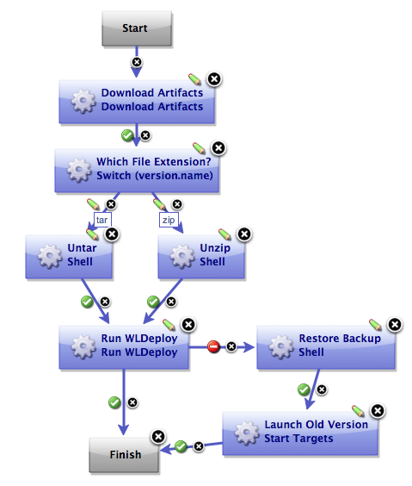
Process editor
A graphical editor in which to construct elemental processes to complete operations on resources.
A drag-and-drop interface to create process flows.
Web based and accessible through the UrbanCode Deploy server.
Parameter-based logic, which is highly customizable.
Ability to write customized procedures and plug-ins.
Notes:
.

Slide 43
Representation model review questions:
What is a component?
What is a resource?
What is a snapshot?
What is deployed to an environment?
What are processes packaged with and what are they executed by?

Slide 44
Simple deployment demonstration
Let’s take a look at an example of a simple deployment of the JPetStore application.
Notes:
The instructor can do a live deployment demonstration or show a video of a simple deployment. Or even do both. https://www.youtube.com/watch?v=uDTmFFH24Xo

Slide 45
Model elements in the web user interface

Slide 46
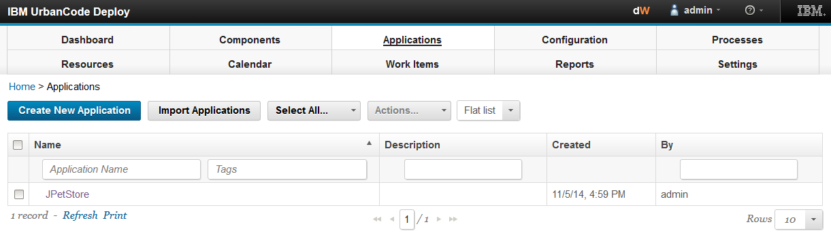
Use tabs to access model elements
Access the structural elements by using the tabs.

Slide 47
Model structure is reflected in the navigation
Click the Applications tab to see a list of applications under management…
Click the name of an application to drill down into the details.

Slide 48
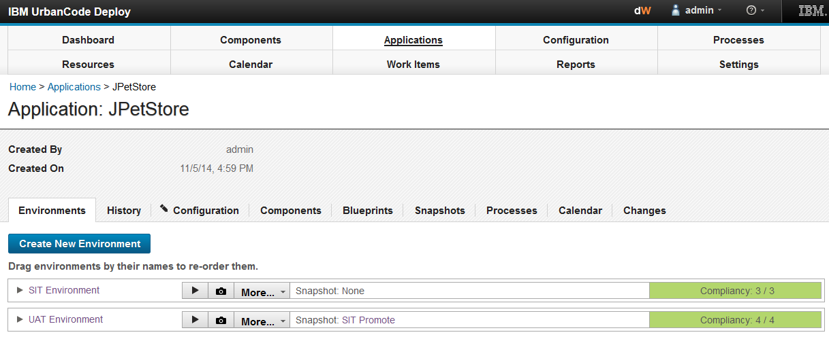
Drilling down into an application
Subtabs provide functions that are in context with what you are viewing.

Slide 49
Navigating back
With the breadcrumb, you can navigate back up the hierarchy.

Slide 50
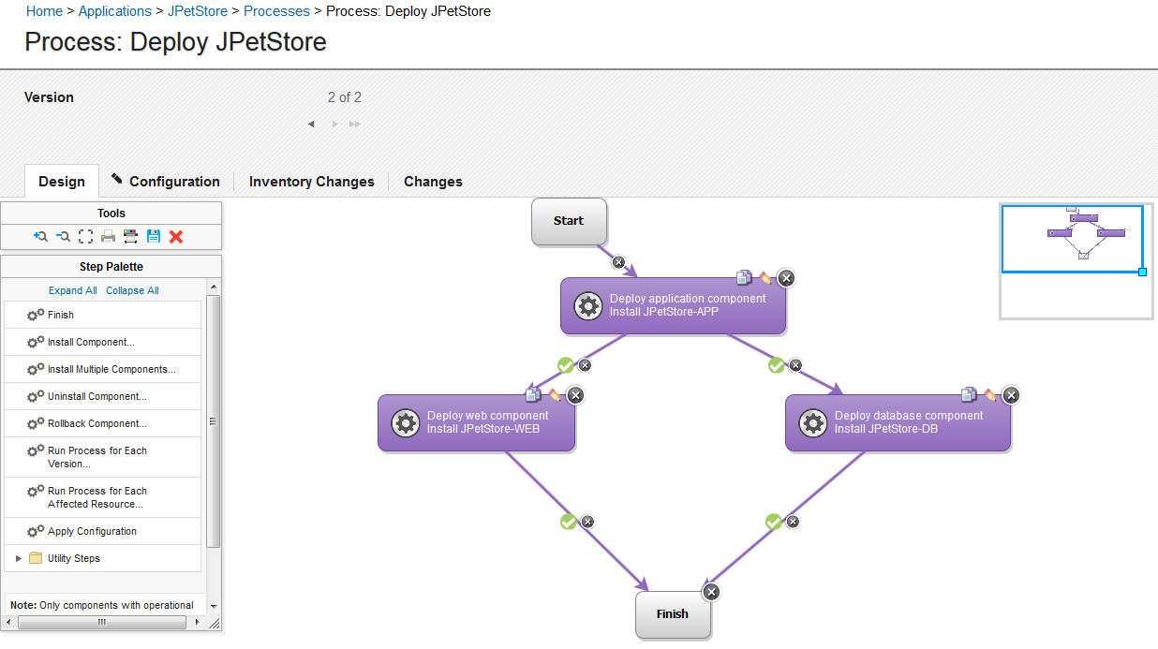
The Process editor
With the Process editor, you can drag processes to create logical workflows from many prebuilt operations.

Slide 51
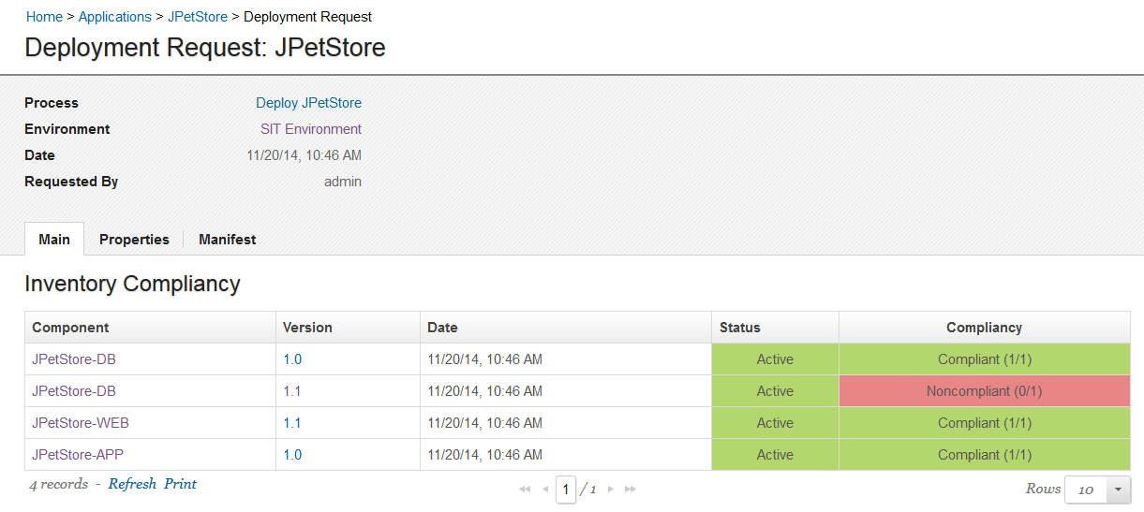
Results are logged
In the web user interface, you can see the results of an attempt to deploy components into environments.

Slide 52
Artifact repositories versus software configuration management
Artifact repositories:
Locations where creators of deployable components are deposited and distributed to many types of users
Software configuration management (RTC or GIT) systems:
Locations where source code is deposited by and distributed to developers
Similarities:
Both use content-addressable storage to contain and distribute data.
Both maintain a notion of “versions” of the elements that they hold.
Both require credentials for access.

Slide 53
The continuous delivery pipeline

Slide 54

Agents
Light-weight processes that are installed on every deployment target (resource).
Provide two-way communication with the UrbanCode server
Stateless (resilient to network outages)
Can be secured by using SSL
Built on Java (requires JVM 1.7 or later)
Notes:
Agents
Complete the actual work of deploying the components of an application
Are extensible through a plug-in architecture
Enable Groovy code to be executed on target systems
Agents with relay servers
In simple configurations, agents communicate directly with the UrbanCode server.
In more complex situations, this communication becomes inefficient or impossible.
The number of agents increase from tens to hundreds to thousands.
Network topology becomes complex.
Agent-server communication crosses firewalls with port restrictions.
Agent Relay Servers resolve this issue:
Can connect large groups of agents to the primary server.
Reduce server load by reducing the number of connections to the primary server.
Simplify firewall rules for communicating across networks.
Help organize agents into logical groups.

Slide 55
Agent processes: Monitor and worker
An agent consists of a worker process and
a monitor process.
Agent
Resource
Monitor
Worker
(JMS)
Plug-in
Run-time
Installed as a service
Multi-threaded
Non-JMS HTTP
Notes:
The worker is as follows:
A service that is a multi-threaded process
A service that performs the actual deployment work on the target resource
The monitor is as follows:
A service that manages the worker process: starting and stopping the process
A service handles restarts, upgrades, and security
Work commands come from plug-in steps, which provide integration with many third-party tools.
After an agent is installed, it can be managed from the UrbanCode Deploy web application.

Slide 56

Server-agent communication
Most agent communication is via JMS (bi-directional).
Some activities use HTTP, however (one-directional from agent to server):
Posting logs
Transmitting test results
Posting files to CodeStation
UrbanCode Deploy server
JMS Channel*
Agents
JMS:7918
HTTP / REST
HTTP:8080
HTTPS:8443
*The agent polls for items in the queue to initiate communication.
Notes:
Security for server and agent communication
By default, UrbanCode Deploy uses these security measures:
Secure Socket Layer (SSL) in unauthenticated mode for JMS-based server/agent communication. Communication is encrypted and decrypted, but agents do not have to authenticate with the server.
Unsecured HTTP for agent-to-server messages as described earlier.
HTTP communication can be secured with SSL:
At installation time
After installation through configuration changes
Stateless server-agent communication
Significant benefits to performance, security, availability, and disaster recovery are provided.
A transaction consists of an independent message.
The message can be synchronized to secondary storage as it is sent.
This synchronization results in resilience to network outages. Either endpoint, server or agent, can be taken down and brought back up without repercussion (other than lost time).

Slide 57
Agents and the relay server
In simple configurations, agents communicate directly with the UrbanCode server.
In more complex situations, direct communication becomes inefficient or impossible:
The number of agents increase from tens to hundreds to thousands.
Network topology becomes complex.
Agent-server communication crosses firewalls with port restrictions.
Agent relay servers resolve this issue.
Notes:
Agent relay servers can connect large groups of agents to the primary server
Reduces server load by reducing the number of connections to the primary server
Simplifies firewall rules for communicating across networks
Helps organize agents into logical groups

Slide 58

Topology example with an UrbanCode Deploy relay server
QA department network
JMS channel
Agents
HTTP or REST
Primary server
Relay server
Development department network
Relay server

Slide 59
Resources
See the material posted on the Urban Code Release and Deploy learning circle – learning circle link
Notes:
Go to ibm.com and search on Learning circle and select the UrbanCode Release and Deploy learning circle. https://www.ibm.com/developerworks/mydeveloperworks/activities/service/html/mainpage#activitypage,657e717a-8c4a-4835-a1c1-c65fbd226103

Slide 60
Module summary
In this module you learned about:
Problems that UrbanCode Deploy helps to solve
A workflow for a basic deployment
The purpose of snapshots and inventory
User interface navigation
The UrbanCode Deploy topology
Server and agent communication

